Slide 1

Project On
BUISNESS PROBLEM
Bankruptcy Detection

Slide 2

Atit Dupare
Kalpana Patil
Vivek Gangurde
Sanjay Gowda
Jeyashree J K
Kavya d k
Sanjay Hemanth
TEAM MEMBER
Mentor: M.Rajshekaran

Slide 3


BUISNESS PROBLEM

Slide 4

At least eight out of every ten business owners at some point face financial difficulty.
Whether it's the overall economy or poorly design business strategies, there are only three choices for a business that faces the financial crunch.
1
Find a way to secure more financing,
2
Default on your loans
3
File for a business bankruptcy.
4
To identify the credibility of the business owner.

Slide 5



OBJECTIVES
1
Classifying the Bankruptcy based on the Risk Factor
To better understanding of bankruptcy and the ability to predict it will impact affect the profitability of lending institutions worldwide
To Build different supervised machine learning algorithms, along with a comparative analysis of each model, in order to identify those that are better suited for predicting bankruptcy.
To identify Which category influence more according to their risk criteria
2
3
Risk Categorise into low medium,high

Slide 6

Flowchart
Exploratory Data Analysis
Clean Dataset
Raw Data Collected
Data Is Processed
Statistical Observation
Models & Alorithum
Models & Algorithm
Selecting Best Model for Deployment
Model Data Prediction & Evaluation
Communicate Visualization Report

Slide 7
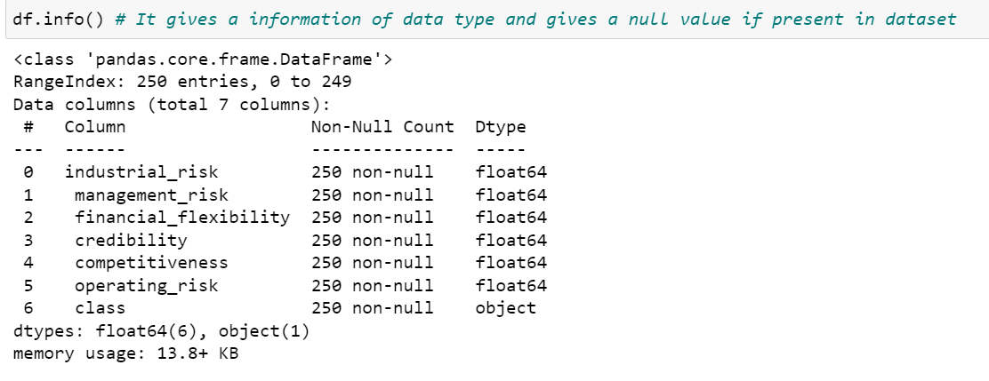
Expletory Data Analysis

Slide 8
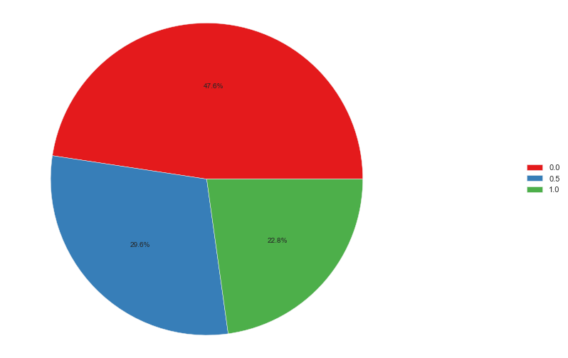
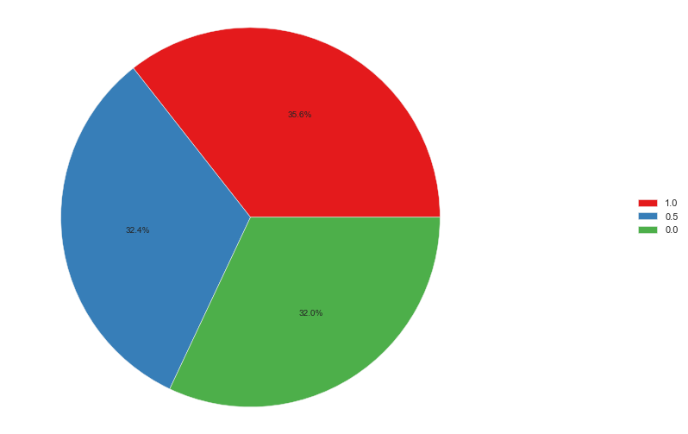
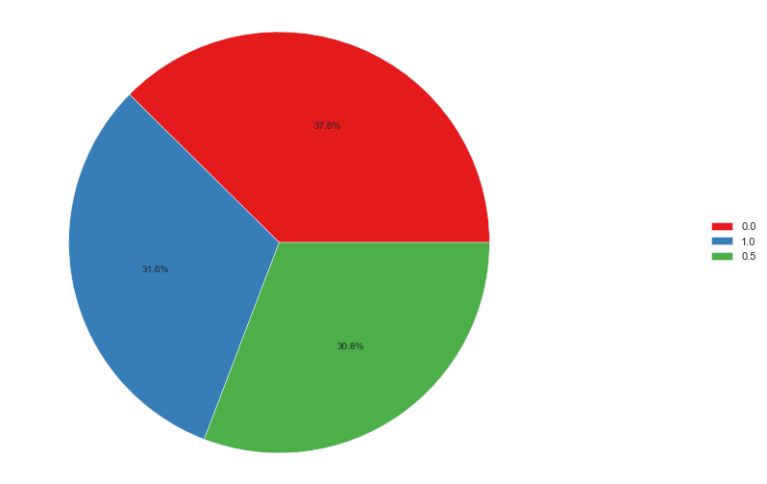
Univarient Analysis
Financial_Flexibility
Industry_Risk
Credibility
Low Risk
Medium
High Risk

Slide 9
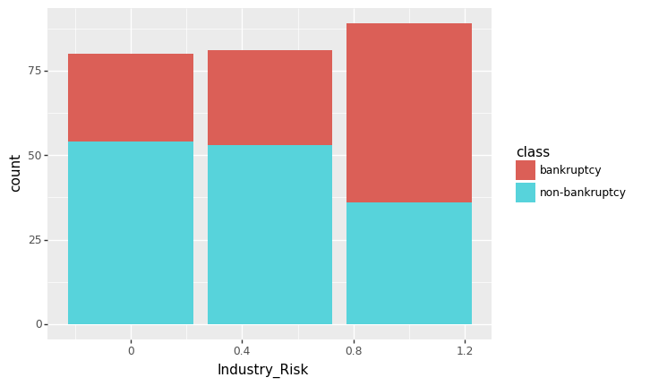
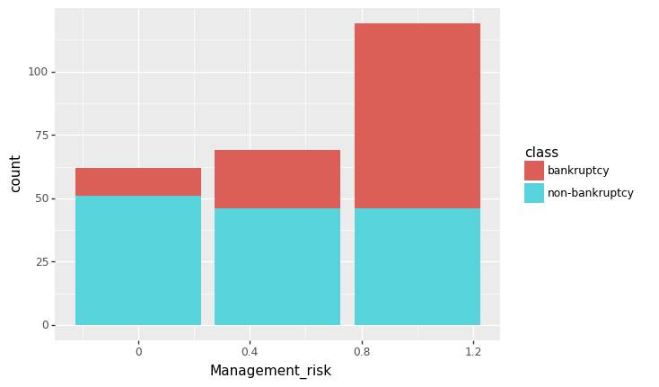
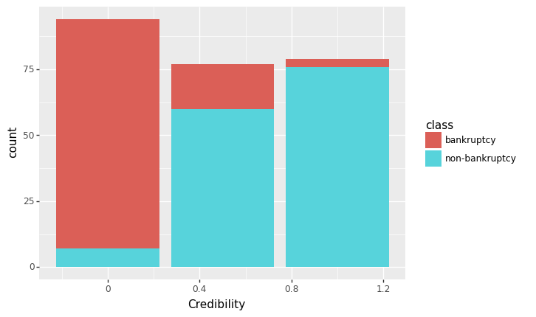
Bi-Varience Analysis
Industrial_Risk,Management_Risk, Credibility_Risk are the features who have the maximum numbers of high risk factor associated with bankruptcy and vice versa.

Slide 10
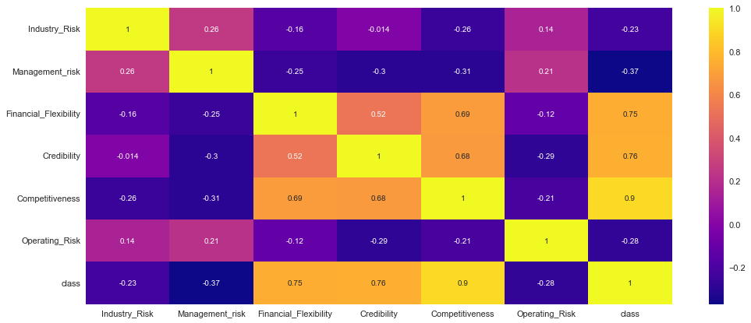
We observed that there is some positive correlation between features like "financial", credibility & Competitive with class variable/target variable
financial & competitive have the maximum positive correlation of 0.69. Followed by finacial & credibility..

Slide 11

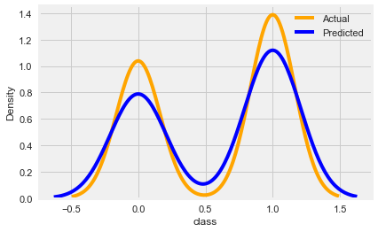
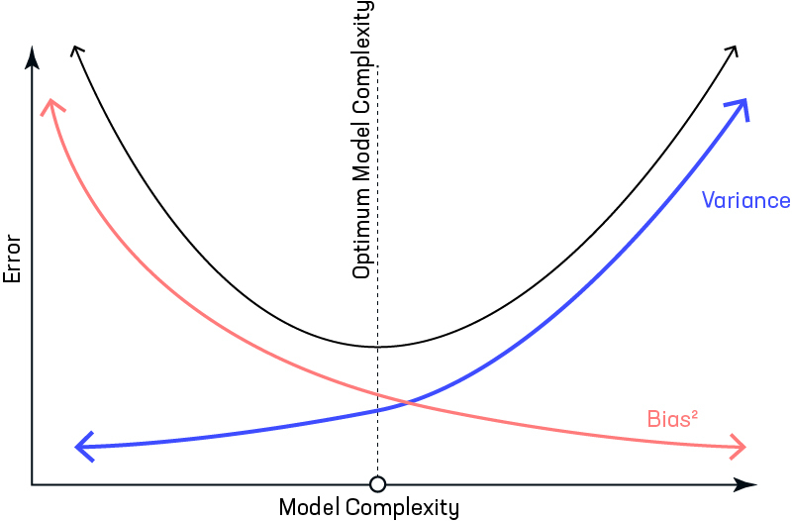

Model Building Using Train Test
Model Selection Using Bias & Varience
Varience Loss 0.013
bias: 0.013
SVC Model
Fits Here
Actual data is our train data
Predicted data is our test data
First Spike indicates the Memorized the data
secound spike indicate generalize data

Slide 12
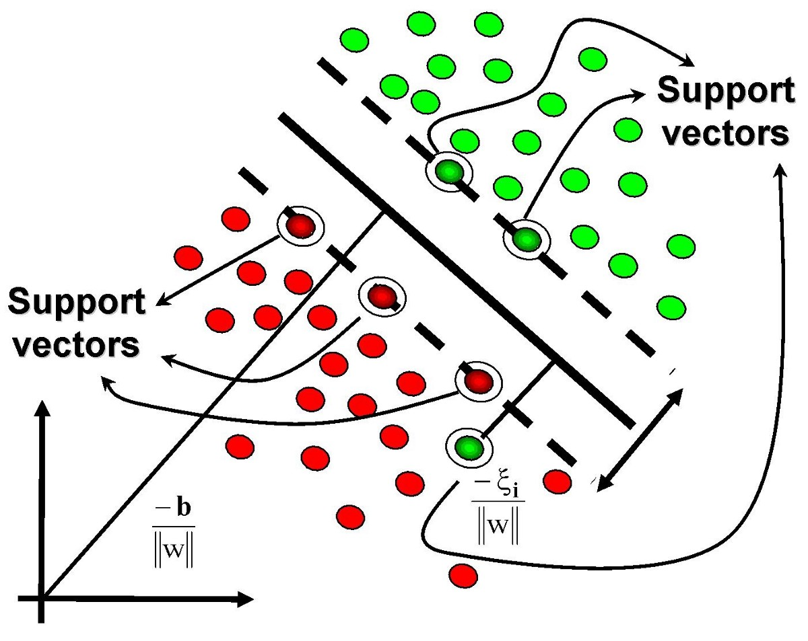

Slide 13
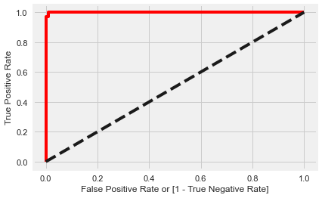
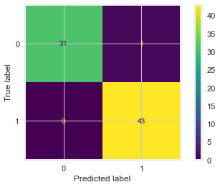
Evaluation Of Model
Confusion Matrix
True Positive 43 True Negative 31
False Positive 1, False Negative 0
ROC Curve

Slide 14
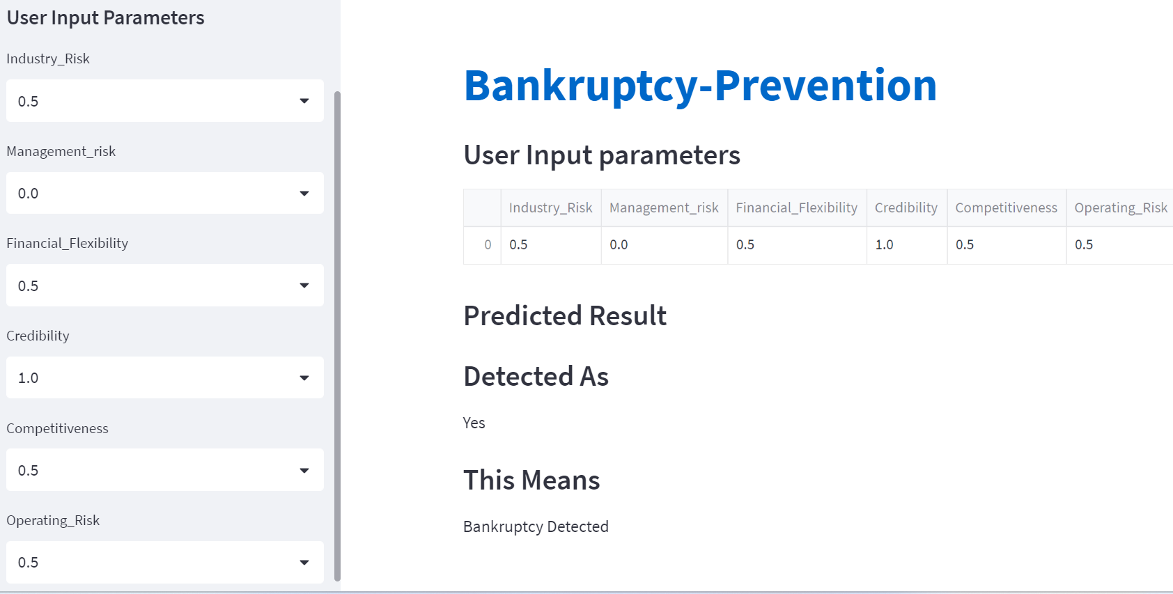

Slide 15
https://atit19-bankruptcy-prediction-bankruptcypy-filegui-tak5xm.streamlit.app/

Slide 16
Challenges
1-We face a challenges to deployment of our project on streamlit.
2-We have old updated version so we need to upgrade the versions of library’s
3-Selecting a proper model as all models gives us a 100 % accuracy
4-we face a challenge to get a procfile and shell file
5-In data set there is lot of duplicated data points

Slide 17
THANK
YOU!

